Slide 1
Cleaning Data Using SQL
Jeremy Bergmann - Omaha Data Science Academy

Slide 2
What is the need for data manipulation?
Creating new datasets & Combine disparate data sets
Perform common queries, aggregations, and joins
Adding, removing, or modifying data
Extracting and Storing Data
Creation/Extraction
Transformation data
Cleaning data
Storage & Retrieval
Notes:
Creation: creating tables and databases, the things
Storage: where data are stored
Cleaning: adding, removing, or modifying data
Retrieval: selecting only the data you want

Slide 3
Project Milestones
Import data into MySQL database (Class 1)
Query Data for Data Understanding/Relevant Information (Class 2)
Storing/Joining data for analysis (Class 3-4)
Cleaning Data (Class 5)
Normalize Data & Create Data Model (Class 6)
Analyze Data Quality & Create Data Dictionary (Class 7)
Connect Data to PowerBI Desktop/Cloud, Answer Business Questions Automate data workflow using ETL (Python - Optional) (Class 8)

Slide 4
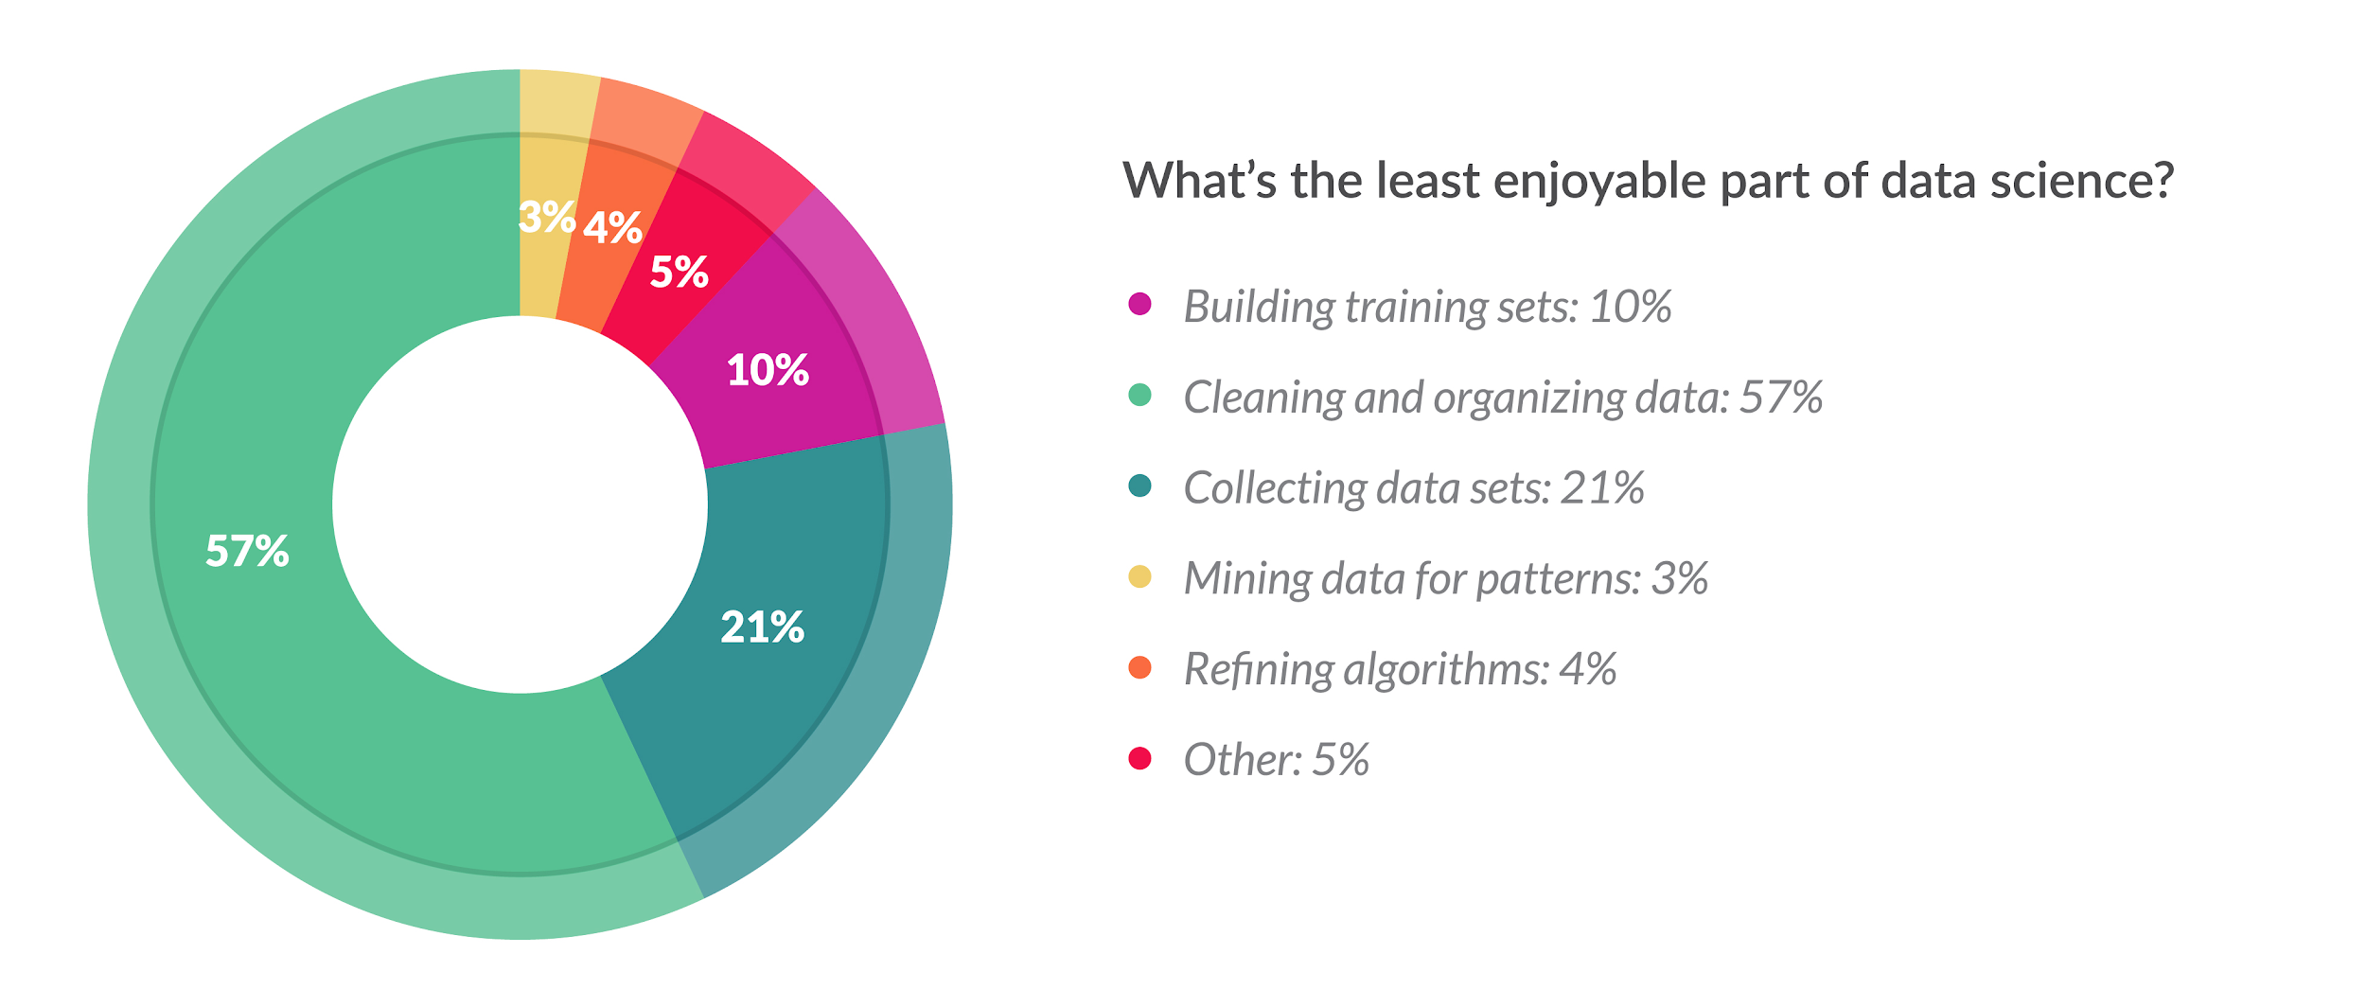
Cleaning Data
What Does Cleaning Data Mean?
Data cleaning is the process of confirming the Validity, Accuracy, Completeness, Consistency, and Uniformity data
How Can You Clean Data?
Using business knowledge, along with software tools or a coding language to clean data.
What About Programming Languages?
Cleaning data in a language like SQL or Python gives you flexibility to run routines for specific projects, while keeping costs low
Python: Pandas, Dora, data cleaner, tabulate, scrubadub, and many other Python libraries.
SQL: T-SQL, Text & Date Functions, Case Statements, “Where” clause, Select Distinct
Notes:
Validity - absence of differences between the data items representing the same objects based on specific information requirements
Accuracy - degree to which the data item correctly describes the object in context of appropriate real-world context and attributes
Completeness - An indication of the comprehensiveness of available data,
Consistency - absence of differences between the data items representing the same objects based on specific information requirements (across data sources/Tables)
Uniformity - Absolute, or very high degree of, comparability between two or more alternatives, processes, products, qualifications, sets of data

Slide 5
Goals of Cleaning Data
Remove Unwanted Observations for your dataset, including duplicate and irrelevant observations
Duplicate Observations arise when you combine datasets from multiple places, scrape data, and receive data from clients/other departments.
Irrelevant Observations & Outliers are those that don’t fit the specific problem you’re trying to solve. It may be useful in other projects, but not this particular one.
Fix Structural Errors that occur during measurement or data transfer. This can be something as simple as multiple ways to spell a word or mislabeled classes; Parsing is an example of finding syntax errors.
Handle Missing Data is a must. It’s bad practice to ignore missing values in your dataset, because many algorithms do not accept missing values. You have two options when handling missing data:
Dropping observations that have missing values
Imputing the missing values based on other observations. Appending is a method of cross-referencing multiple data sources and combining known data into a final data.
There are other possible ways to clean data, such as, transforming files, applying statistical methods, and post-processing, but these four steps will always be performed on any dataset you will analyze.
Notes:
The goal of cleaning is ultimately to confirm the Validity, Accuracy, Completeness, Consistency, and Uniformity of the dataset.
There are 4 main methods of cleaning data:

Slide 6
SQL Wildcards
Purpose: Used with the SQL “Like” operator, A wildcard character is used to for comparing strings or for string-cleaning purposes.
Symbol | Description | Example
% | Represents zero or more characters | bl% finds bl, black, blue, and blob
_ | Represents a single character | h_t finds hot, hat, and hit
[] | Represents any single character within the brackets | h[oa]t finds hot and hat, but not hit
^ | Represents any character not in the bracket | h[^oa]t finds hit, but not hot and hat
- | Represents a range of characters | c[a-b]t finds cat and cbt
Notes:
“Main clauses” in descending order of operations
LIKE: wildcard searches: %<char>, %<char>%, <char>%, underscores
Wildcard characters: %, _, *

Slide 7
Case Statements
Purpose - The CASE statement goes through conditions and return a value when the first condition is met (like an IF-THEN-ELSE statement). If no conditions are true, it returns the value in the “ELSE” clause.
Syntax
CASE WHEN condition1 THEN result1 WHEN condition2 THEN result2 WHEN conditionN THEN resultN ELSE result END;
Example
SELECT view.Country,
CASE WHEN Country = 'India' THEN 'Gandhi'
WHEN Country = 'Nepal' THEN 'Mt. Everest'
WHEN Country = 'China' THEN 'Great Wall'
ELSE 'Unknown' end as famous_stuff
FROM world.vw_countries_asia as view
WHERE view.Country in ('India', 'China', 'Nepal','Taiwan')

Slide 8
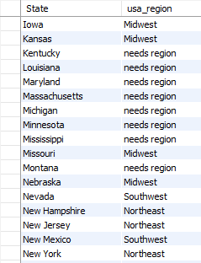
Ex. Operators & Case Statement
Classify US States into their geographical “regions”
SQL Query
SELECT distinct District as State,
case when District in ('Nebraska','Iowa','Missouri','Kansas') then 'Midwest'
when District = 'New Mexico' or District = 'Nevada' then 'Southwest'
when District like ('N_w%') then 'Northeast'
when District like ('%Dakota') then 'Midwest'
else 'needs region' end as usa_region
FROM world.city
where CountryCode='USA'
order by State
Legend - Wild Cards, Distinct
Notes:
“Main clauses” in descending order of operations
LIKE: wildcard searches: %<char>, %<char>%, <char>%, underscores
Wildcard characters: %, _, *
CASE: if-then statements
JOIN: mostly use INNER, LEFT
HAVING: WHERE for groups (http://www.mysqltutorial.org/mysql-having.aspx)
BETWEEN is inclusive

Slide 9

Removing Duplicates
Purpose - Improve the Accuracy, Consistency and the Uniformity of data by removing identical observations that appear more than 1 time in a SQL Table.
3 Methods
1. Select “Distinct” Keyword
2. Finding Duplicates by Key (joins)
3. Finding Duplicates via Aggregation
Notes:
https://codingsight.com/multiple-ways-to-remove-duplicates-from-sql-tables/

Slide 10
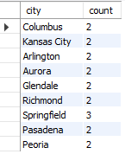
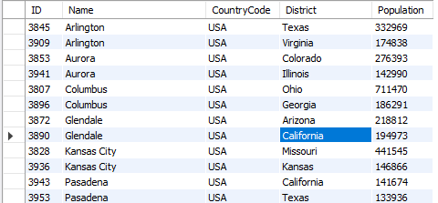
Ex. Identifying Duplicates
Find USA Cities with the same name (duplicate records)
SQL Query - Find Via Aggregate & Join
SELECT a.*
FROM world.city a inner join
(SELECT `Name` as city, sum(1) as count
FROM world.city
where CountryCode='USA'
Group by `Name`
Having count > 1) as b on a.Name = b.city
where a.CountryCode='USA'
order by a.Name
Notes:
“Main clauses” in descending order of operations
LIKE: wildcard searches: %<char>, %<char>%, <char>%, underscores
Wildcard characters: %, _, *
CASE: if-then statements
JOIN: mostly use INNER, LEFT
HAVING: WHERE for groups (http://www.mysqltutorial.org/mysql-having.aspx)
BETWEEN is inclusive

Slide 11
Numeric Formatting Functions
Function | Description | Example
FORMAT (N, D) | Number N to a format like ‘#,###,###.##’ rounded to a number of decimal places | SELECT FORMAT(12324.2573, 3) = 12,324.257
CAST (value, type) | The CAST() function converts a value (of any type) into the specified datatype. | SELECT CAST ('150' AS Unsigned)= 150
IFNULL(expr ,alt_value) | returns a specified value if the expression is NULL. | IFNULL(NULL, 500) = 500
ISNULL(exp) | returns 1 or 0 depending on whether an expression is NULL. | ISNULL(NULL) = 1
COALESCE (val1, val2, ...., val_n) | Function returns the first non-null value in a list. | COALESCE(NULL, NULL, NULL, 'W3Schools.com', NULL, 'Example.com') = 'W3Schools.com'
Notes:
See more numeric functions at: https://www.w3resource.com/slides/mysql-mathematical-functions-slides-presentation.php
For Cast() data types, see: https://www.w3resource.com/slides/mysql-mathematical-functions-slides-presentation.php

Slide 12
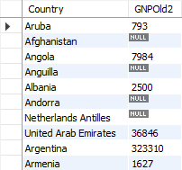
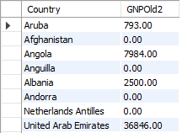
Ex. Numeric Functions
Fill-in and convert `GNPOld` values in World.Country
SQL Query - Undesired Types - Convert Decimal to Integer
SELECT Name as Country, convert(round(GNPOld,0),unsigned) as GNPOld2 FROM world.country;
SQL Query - Coalesce “0” for Null Values
SELECT Name as Country, coalesce(GNPOld,0) as GNPOld3 FROM world.country;

Slide 13
String Formatting Functions
Function | Description | Example
CONCAT (Str1,..,StrN) | add two or more strings | SELECT CONCAT(“Jeremy “,”Bergmann”) = ‘Jeremy Bergmann’
INSTR (orig, substr) | Returns an integer which indicates the position of the first occurrence of the substr. | INSTR('myteststring','st') = 5
TRIM (expr ,alt_value) | string after removing all prefixes or suffixes from the given string. | TRIM(LEADING 'leading' FROM 'leadingtext' ) = ‘text’
REPLACE (str, find, sub) | replaces all the occurrences of a substring within a string | REPLACE('w3resource','ur','r') = ‘w3resorce’
LCASE(str), UCASE(str) | converts the characters of a string to lower/upper case characters. | LCASE('MYTESTSTRING') = ‘myteststring’
LENGTH(str) | returns the length of a given string. | Length(‘Bergmann’) = 8
SUBSTRING
Notes:
See more numeric functions at: https://www.w3resource.com/slides/mysql-mathematical-functions-slides-presentation.php
For Cast() data types, see: https://www.w3resource.com/slides/mysql-mathematical-functions-slides-presentation.php

Slide 14
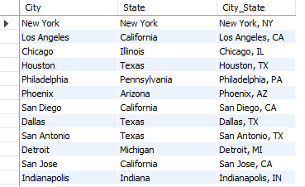
Ex. String Functions
Convert USA City & State Names to “City, St.” in World.City
SQL Query
SELECT `Name` as City, District as State ,
concat(`Name`, ‘,',
case when District = 'New York' then 'NY'
when trim(Leading 'Penn' from District) = 'sylvania' then 'PA'
when instr(District,'Tex') then 'TX'
when District = 'Arizona' then Replace(District, 'Arizona', 'AZ')
else upper(left(District,2)) end
) as City_State
FROM world.city as a where a.CountryCode='USA'

Slide 15
Date Formatting Functions
Function | Description | Example
CURDATE() | returns the current date in 'YYYY-MM-DD' format | SELECT CURDATE() = '2019-07-22'
CURRENT_TIMESTAMP() | eturns the current date and time in ‘YYYY-MM-DD HH:MM:SS’ format | CURRENT_TIMESTAMP() = ‘2019-07-22 13:41:53’
HOUR(time) | returns a specified value if the expression is NULL. | HOUR(CURRENT_TIMESTAMP()) = 13
Datediff(date1, date2) | Returns the number of days between two dates or datetimes (using only date portion) | Datediff(CURDATE(), ‘1999-12-31’) = 7143
DAYOFWEEK(date) | returns the week day number (1 for Sunday,2 for Monday …… 7 for Saturday ) | DAYOFWEEK(CURDATE()) = 2
DAY(date), Month(date), Year(date) | following statement will return the day of the month/month of year/calendar year of the input date. | DAY('2008-05-15') = 15 MONTH('2008-05-15') = 5 YEAR('2008-05-15') = 2008
Notes:
See more numeric functions at: https://www.w3resource.com/slides/mysql-mathematical-functions-slides-presentation.php
For Cast() data types, see: https://www.w3resource.com/slides/mysql-mathematical-functions-slides-presentation.php

Slide 16
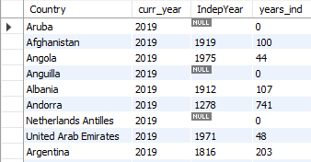
Ex. Date Functions
Get the number of years since each country’s independence
SQL Query
SELECT `name` as Country, year(curdate()) as curr_year, IndepYear,
case when IndepYear is null then 0
else year(curdate())-IndepYear end as years_ind
FROM world.country;

Slide 17

Class Project
Cleaning Data
The COO would like to know the volume of existing pre-orders for console games, to predict the most popular upcoming game genres. Utilize and clean the “USA Pre-Order Chart” data to answer this question.
1. Use the “USA_PreOrders_Import.sql” file to create a table populated with preorder data, in the “Class Project/Consoles” folder.
2. Create a “USA_PreOrder_Chart” view that cleans-up the following data.
Change the “N/A” values in the “Weeks to Launch” column to 30, then cast the field as an Integer
Create “Console”, “Company” and “Genre” fields from the text in “Game_Console_Company_Genre”
For 1-10, Fill-In the “Game” & “Genre” columns with relevant values
Calculate the difference between today and the date the preorder list was last published. (‘2018-12-29’)
4. Select “Genre” and “Weeks to Launch” from the view you created, then summarize by “Total”. What Genre has the top pre orders as of EOY 2018, and what genre do you think will be best in 2019?
Notes:
USA Pre-Order Chart from (29-Dec-2018): http://www.vgchartz.com/preorders/43464/USA/

Slide 18
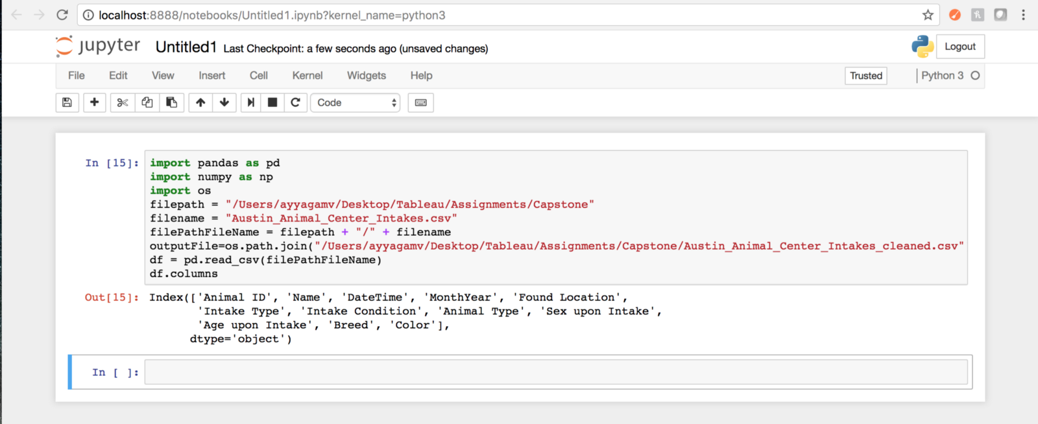
Appendix - Cleaning data: Python
Data scientists spend a large amount of their time cleaning datasets and getting them down to a form with which they can work. In fact, a lot of data scientists argue that the initial steps of obtaining and cleaning data constitute 80% of their job.
Tasks - Using Pandas Library
Dropping unnecessary columns in a Pandas DataFrame
Using .str() methods to clean columns
Using the DataFrame.applymap() function to clean the entire dataset, element-wise
Renaming columns to a more recognizable set of labels
Skipping unnecessary rows in a CSV file
Resource: Python for Data Analysis (O’Reilly)
*Cleaining Strings in python: https://mode.com/sql-tutorial/sql-string-functions-for-cleaning/
Notes:
Common ways to clean data with Python are available in the many libraries that you can import in your code. One of the most popular libraries is Pandas, which was designed for data manipulation and analysis, but is most commonly associated with data cleaning. Here is a common code snippet where Pandas is imported to clean a set of data:

